Slide 1
Maps – What, Where, How?
Abhiram R
ML Engineer
O9 Solutions

Slide 2
What?
Geographical representation on 2 dimensions.
Geographic Information Systems
Geospatial Data Representation :
As raster data : Uses matrices of pixes – For continuous data such as density of color on grass (rioxarray)
As vector data : Uses points, lines , polygons to represent locations and boundaries of objects and areas (shp)

Slide 3
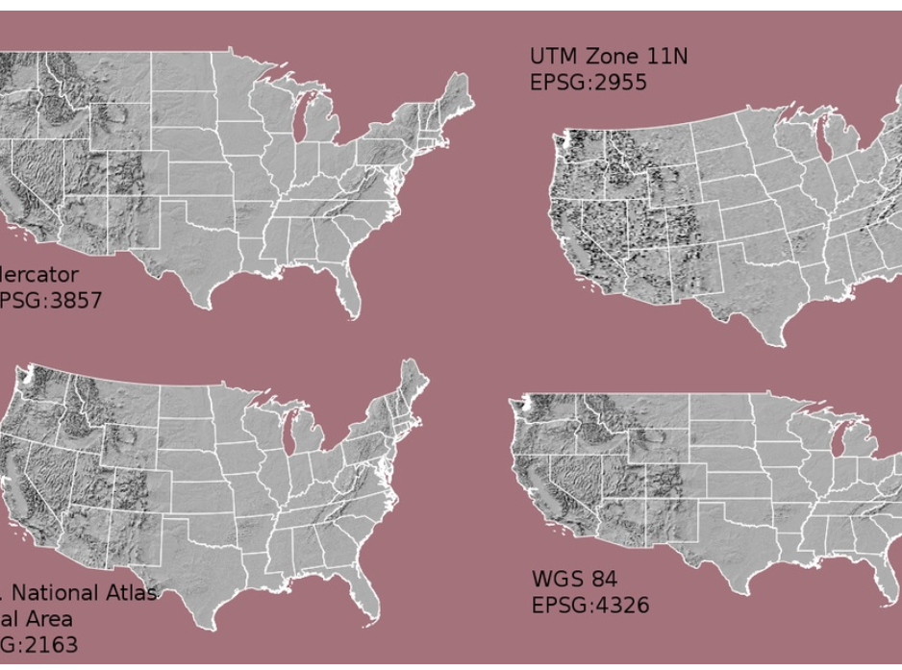
Datastructures
Raster attributes :
Extent : amount of area covered by raster data
Resolution : amount of area covered by each pixel
Coordinate Reference System
NoDataValues

Slide 4
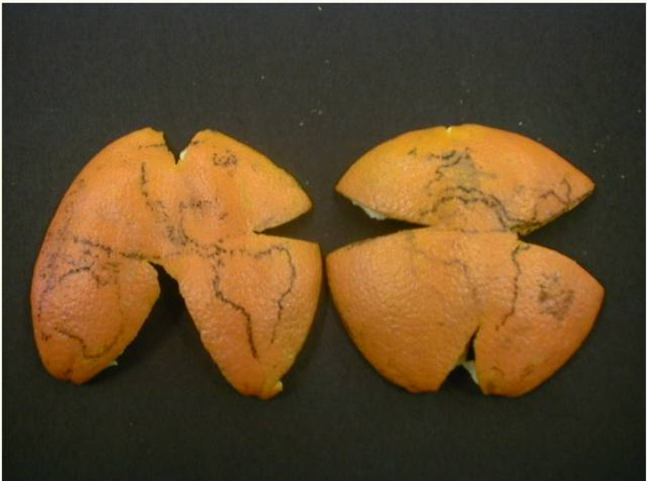
Datastructures (cont.d)
Vector attributes :
Extent
Object Type – Point, Line or Polygon
Coordinate Reference System
A model of the shape of the earth. 3D ->2D.
Components : Datum (Which fruit) , Projection (how the fruit is peeled)

Slide 5
Software packages
ESRI ArcGis – Proprietary, Very popular
Google Earth
GRASS GIS (Geographic Resources Analysis Support System)
Qgis – Open Source, C++, GUI
PostGIS
Leaflet JS

Slide 6
Data and packages of interest
Shp files (Shape files) – How to procure them?
How to use them?
Other extensions – prj, dbf
Check Jupyter notebooks

Slide 7
References
https://www.notion.so/abhidotr/Notes-from-Feb-2021-Bangpypers-Event-1abe9802d78f4c3994857869e9e8b02f

